Slide 1
LCC_CKMeans Protocol

Slide 2
App-Agent communication: Submitting and saving exercise result
MyWelcome app#1
MyWelcome app#m
App-Logic
. . .
App-Logic
Steps:
App-logic sends the exercise results to agent
Agent calculates the course progress level (CPL) by averaging all of the lesson progress levels that were submitted so far.
Agent saves the CPL and submitted scores.
App-Logic
App-Logic
App-Logic Interface
App-Logic Interface
1.1 Send scores to agent#1
1.m Send scores to agent#m
Info package: Reading: …
Writing : …
Grammar : …
Vocabulary : …
Lesson Progress Level : …
Info package: Reading: …
Writing : …
Grammar : …
Vocabulary : …
Lesson Progress Level : …
Agent#1
Agent#m
2.1 Compute Course Progress Level
. . .
2.m Compute Course Progress Level (CPL)
Agent Interface
Agent Interface
LAKR#1
3.1 Save CPL and scores to LAKR
LAKR#1
3.m Save CPL and scores to LAKR

Slide 3
LCC Protocol: Teacher requests grouping proposal
Phase 1.a Teacher selects a list of agents who belong to the same classroom
WPM
Teacher Panel
Info package
Agents:
Agent_1 - active, *cl3
.
Agent_10 - active, cl3
Agent_11 - inactive, cl3
.
Agent_m - inactive. cl3
Phase 1.c.1
Form groups
Phase 1.c.m
Form groups
Phase 1.b. WPM reactivates inactive agents
Info package Form groups with:
*Agent_1,
.
Agent_m
Info package Form groups with:
*Agent_1,
.
Agent_m
WPM Interface
Info package
Agents:
Agent_11,
.
Agent_m
WAR
Agent#1
Agent#m
Agent#n
. . .
. . .
Agent Interface
Agent Interface
Agent Interface
Steps:
Phase 1.a Teacher selects a list of TCNs who belong to the same classroom, via Teacher panel in WPM
Phase 1.b WPM reactivates inactive agents of TCNs such that all agents in the list are active before next step.
Phase 1.c WPM selects (randomly or based on resource availability of the agent) an agent as dedicated agent. WPM attaches dedicated agent and list of agents information to a signal and sends it to each agent to inform them to start coordination.
Communication:
Phase 1.c - m
*Agent_1: indicates that agent_1 is selected as dedicated agent
*cl3: is classroom name - classroom 3

Slide 4
LCC Protocol : Agents share info
Received signal to start coordination
Agent#1
Phase 2.a.10 Send info to dedicated agent
Phase 2.a.m Send info to dedicated agent
Not received any signal
to start coordination
Agent Interface
Phase 2.b Collection of personal info (no preference) from agents
Phase 2.d Generate must-link and cannot-link constraints sets based on individual preferences
Agent#n
Info package:
Gender: …
Nationality: …
CPL: …
Attendance:…
Phase 2.e.10 Send ML and CL to dedicated agent
Phase 2.e.m Send ML and CL to dedicated agent
Info package:
Gender: …
Nationality: …
CPL: …
Attendance:…
Received signal to start coordination
Agent Interface
Info package
Must-link – ML
Cannot-link - CL
Info package
Must-link – ML
Cannot-link - CL
Received signal to start coordination
Agent#10
Phase 2.c.10 Send complete info to agent#10
. . .
Phase 2.c.m Send complete info to agent#m
Agent#m
Agent Interface
Info package
Agent#1 info
.
Agent#m info
Info package
Agent#1 info
.
Agent#m info
Agent Interface
Phase 2.d Generate must-link and cannot-link constraints sets based on individual preferences
Phase 2.d Generate must-link and cannot-link constraints sets based on individual preferences
Steps:
Phase 2.a. Each agent receives the signal and sends its personal info to dedicated agent. Agents don’t share their preferences.
Phase 2.b. Dedicated agent collects the necessary info from coordinating agents and builds the complete info of all agents.
Phase 2.c. Dedicated agent broadcasts the complete info to all agents.
Phase 2.d. Since each agent has the complete info, each of them builds an individual must-link and a cannot-link constraints sets based on their individual preferences. Individual IML and ICL functions are illustrated in the last slides.
Phase 2.e. Each agent sends the ML and CL sets to dedicated agent.
Communication:
Phase 2.a - m-1
Phase 2.c – m-1
Phase 2.e – m-1

Slide 5
LCC Protocol : Agents find solution
Collected ML and CL from all agents
Agent#1
Phase 3.b.10 Send the complete ML and CL to agent#10
Phase 3.b.m Send the complete ML and CL to agent#m
Not participating in the coordination
Agent Interface
Phase 3.a Build the complete ML and CL
Phase 3.c Since all necessary info is collected, solve the problem
Agent#n
Agent Interface
Phase 3.d.10 Send the result to agent#10
Phase 3.d.m Send the result to agent#m
Agent#10
Phase 3.d.w Send the result to WPM
Agent#m
Agent Interface
Agent Interface
WPM
Teacher Panel
WPM Interface
Steps:
Phase 3.a. Dedicated agent builds the complete ML and CL sets by combining all individual IML and ICL sets which are collected from agents. Building complete ML and CL sets function is illustrated in the last slides.
Phase 3.b. (Optional) Broadcast the complete ML and CL to other agents such that they can solve the problem in case dedicated agent is accidentally killed. In this case, WPM signals another agent to become the dedicated agent who must approve that it has the complete ML and CL. Otherwise, it requests all agents to start from phase 2.d again.
Phase 3.c. Since dedicated agent has all the necessary info, it solves the LCC problem by running LCC_CKMeans algorithm (in the last slides) and finds a result.
Phase 3.d. Dedicated agent sends the result to all agents and WPM. (Optional) WPM might decide to request to kill the agents which were involved in the coordination process.
Communication:
Phase 3.b - m-1
Phase 3.d – m

Slide 6
LCC Protocol : Sending final grouping to agents
Teacher received the grouping proposal from agents
Phase 4.a Teacher either
Modifies the proposal
Approves the proposal
WPM
Teacher Panel
Phase 4.c.1 WPM informs agent#1
Phase 4.c.m WPM informs agent#m
Info package:
Send Grouping result only if the teacher modified the proposal
Info package:
Send Grouping result only if the teacher modified the proposal
WPM Interface
Phase 4.b WPM reactivates the inactive agents in the selected grouping
or
or
Info package:
Send Approved only if the teacher approves the proposal
Info package:
Send Approved only if the teacher approves the proposal
Steps:
Phase 4.a. After receiving a proposal, teacher can modify or approve the proposal which is sent by agents.
Phase 4.b. Once the teacher submits/approves, WPM needs to reactivate the inactive agents in the submitted/approved grouping such that all of them can receive the final grouping.
Phase 4.c. WPM informs each agent which is in the final grouping. The signal should contain either the grouping result or “approved”, respectively, depending on whether teacher modifies or approves.
Agent#1
Agent#m
Agent#n
. . .
. . .
Communication:
Phase 4.c - m
Agent Interface
Agent Interface
Agent Interface

Slide 7
LCC Protocol : Informing TCN about his/her group
MyWelcome app#1
MyWelcome app#m
App-Logic
App-Logic
App-Logic
. . .
App-Logic
App-Logic Interface
App-Logic Interface
Phase 5.a.1 Send info to app-logic
Phase 5.a.m Send info to app-logic
Info package: Send the name of group of TCN#1
Info package: Send the name of group of TCN#m
Agent#1
Agent#m
Steps:
Phase 5.a. Once an agent receives the final grouping from WPM (Teacher), it only sends the name of the group of TCN to app-logic. Since agents don’t know the identities of other group members, they send the group name such that TCNs can find each other in the classroom.
Phase 5.b. Agents send coordination_ended signal to WPM.
-* Even if the TCN is logged out when agent sends the group name (at phase 5.a), the agent will still continue to phase 5.b. Since agent stores the group name into LAKR, it is not lost. Therefore, TCN will always be able request it from the agent via app-logic.
. . .
Agent Interface
Agent Interface
Phase 5.b.1 Send coordination ended signal to WPM
Phase 5.b.m Send coordination ended signal to WPM
WPM
Teacher Panel
Communication:
Phase 5.a – m
Phase 5.b – m
WPM Interface

Slide 8
Involved Components and Functionalities to be provided
Agent
MyWelcome app_1
MyWelcome app
MyWelcome app_1
WPM
Dispatcher
App-Logic
Teacher Panel
App-Logic
App-Logic
App-Logic Interface
App-Logic Interface
App-Logic Interface
Agent Interface
Dispatcher Interface
WPM Interface
Teacher panel (doesn’t have to be in WPM)
Teacher panel would be able to receive the proposal from agents.
Receiving coordination_ ended signal
Receive exercise result, calculate and store.
Receive start_coordination signal and share info.
Receive personal info and broadcast to others (dedicated agent).
Receive complete personal info from dedicated agent.
Receive ML and CL from other agents, build and broadcast complete ML and CL.
Solve the LCC, broadcast the result to other agents and share with WPM.
Receive “approved” or grouping from WPM, share with TCN.
Send coordination_ended signal to WPM.
Receive the name of the group of TCN.

Slide 9


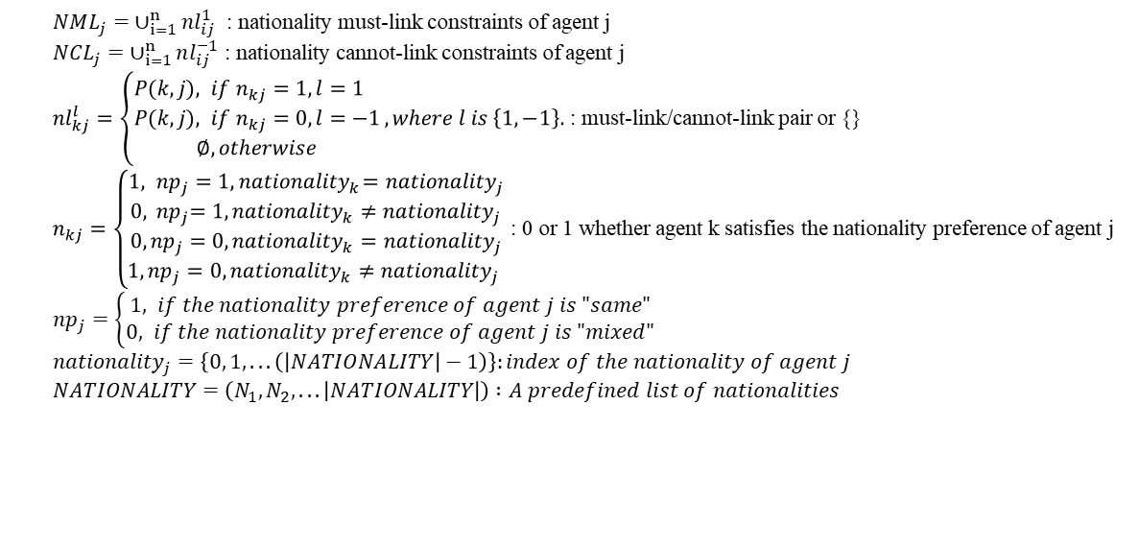
Functions
Complete ML and CL building functions
$ML= ∪_{j=1}^{n}IML_{j}$: complete must-link constraints $CL= ∪_{j=1}^{n}ICL_{j}$: complete cannot-link constraints
Individual IML and ICL functions for an agent
$IML_{j}= GML_{j}∪{NML}_{j}$ : individual must-link constraints for agent j $ICL_{j}= GCL_{j}∪{NCL}_{j}$: individual cannot-link constraints for agent j
Individual nationality NML and NCL functions for an agent
$NML_{j}= ∪_{i=1}^{n}nl_{ij}^{1}$ : nationality must-link constraints of agent j
$NCL_{j}= ∪_{i=1}^{n}nl_{ij}^{−1}$ : nationality cannot-link constraints of agent j
${nl}_{kj}^{l}=\left\{\begin{aligned}P(k,j), &if n_{kj}=1, l=1 \\ P(k,j), &if n_{kj}=0, l=−1 \\ ∅, otherwise\end{aligned}\right.,where l is \left\{1,−1\right\}.$ : must-link/cannot-link pair or {}
$n_{kj}=\left\{\begin{aligned}\begin{aligned}\begin{aligned}1, { {np}_{j}=1, nationality}_{k}={nationality}_{j}& \\ 0,{{ np}_{j}=1, nationality}_{k}≠{nationality}_{j}\end{aligned} \\ 0,{{np}_{j}=0, nationality}_{k}={nationality}_{j}\end{aligned} \\ 1, {{np}_{j}=0, nationality}_{k}≠{nationality}_{j} \end{aligned}\right.$ : 0 or 1 whether agent k satisfies the nationality preference of agent j
${np}_{j}=\left\{\begin{aligned}1, &if the nationality preference of agent j is "same" \\ 0, if the nationality preference of agent j is "mixed"\end{aligned}\right.$
${nationality}_{j}=\left\{0, 1, . . . \left(\left|NATIONALITY\right|−1\right)\right\}:index of the nationality of agent j$
$NATIONALITY=\left(N_{1}, N_{2}, . . . \left|NATIONALITY\right|\right) :A predefined list of nationalities$

Slide 10
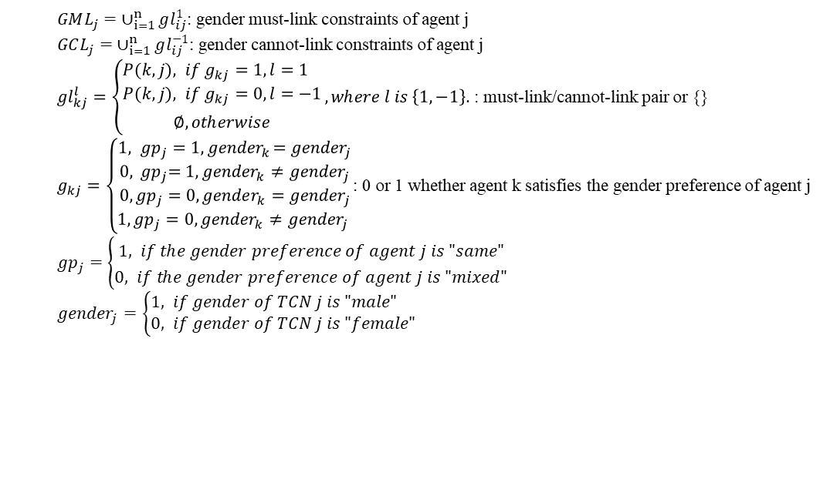
Functions
Individual gender GML and GCL functions for an agent
$GML_{j}= ∪_{i=1}^{n}gl_{ij}^{1}$: gender must-link constraints of agent j
$GCL_{j}= ∪_{i=1}^{n}gl_{ij}^{−1}$: gender cannot-link constraints of agent j
${gl}_{kj}^{l}=\left\{\begin{aligned}P(k,j), &if g_{kj}=1, l=1 \\ P(k,j), &if g_{kj}=0, l=−1 \\ ∅, otherwise\end{aligned}\right.,where l is \left\{1,−1\right\}.$ : must-link/cannot-link pair or {}
$g_{kj}=\left\{\begin{aligned}\begin{aligned}\begin{aligned}1, { {gp}_{j}=1, gender}_{k}={gender}_{j}& \\ 0,{{ gp}_{j}=1, gender}_{k}≠{gender}_{j}\end{aligned} \\ 0,{{gp}_{j}=0, gender}_{k}={gender}_{j}\end{aligned} \\ 1, {{gp}_{j}=0, gender}_{k}≠{gender}_{j} \end{aligned}\right.$: 0 or 1 whether agent k satisfies the gender preference of agent j
${gp}_{j}=\left\{\begin{aligned}1, &if the gender preference of agent j is "same" \\ 0, if the gender preference of agent j is "mixed"\end{aligned}\right.$
${gender}_{j}=\left\{\begin{aligned}1, &if gender of TCN j is "male" \\ 0, &if gender of TCN j is "female"\end{aligned}\right.$

Slide 11
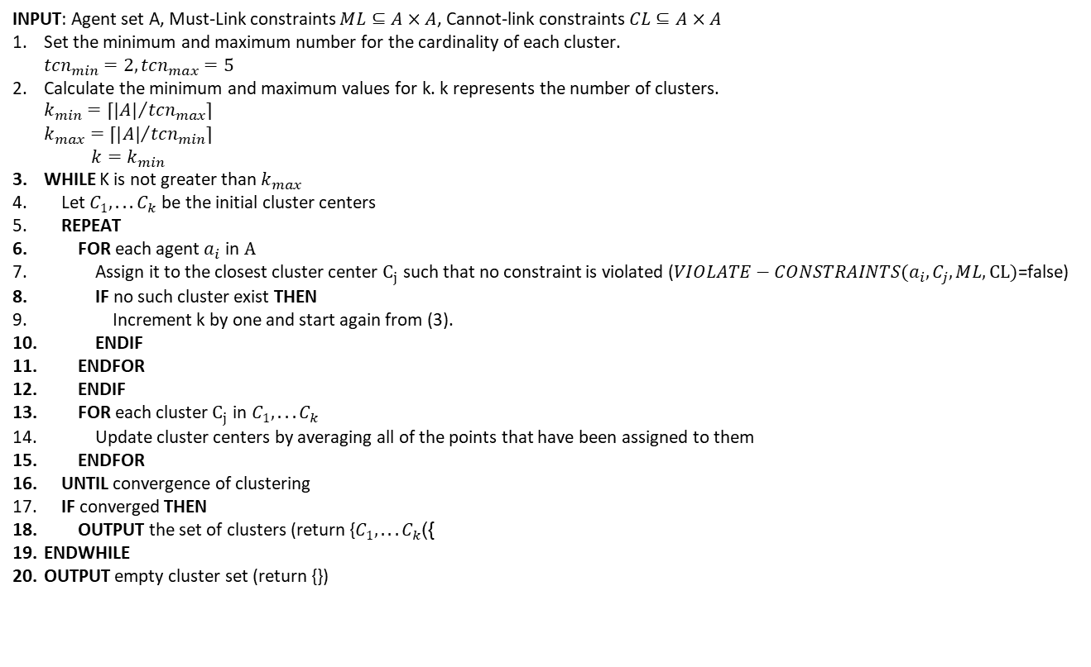
Functions
LCC_CKMeans algorithm
INPUT: Agent set A, Must-Link constraints $ML⊆A×A$, Cannot-link constraints $CL⊆A×A$
Set the minimum and maximum number for the cardinality of each cluster. ${tcn}_{min}=2,{tcn}_{max}=5$
Calculate the minimum and maximum values for k. k represents the number of clusters. $\begin{aligned}k_{min}=⌈{|A|}/{{tcn}_{max}}⌉ \\ k_{max}=⌈{|A|}/{{tcn}_{min}}⌉ \\ k=k_{min}\end{aligned}$
WHILE K is not greater than $k_{max}$
Let $C_{1},...C_{k}$ be the initial cluster centers
REPEAT
FOR each agent $a_{i}$ in $A$
Assign it to the closest cluster center $C_{j}$ such that no constraint is violated ($VIOLATE−CONSTRAINTS(a_{i},C_{j},ML,CL)$=false)
IF no such cluster exist THEN
Increment k by one and start again from (3).
ENDIF
ENDFOR
ENDIF
FOR each cluster $C_{j}$ in $C_{1},...C_{k}$
Update cluster centers by averaging all of the points that have been assigned to them
ENDFOR
UNTIL convergence of clustering
IF converged THEN
OUTPUT the set of clusters (return {$C_{1},...C_{k}$})
ENDWHILE
OUTPUT empty cluster set (return {})

Slide 12
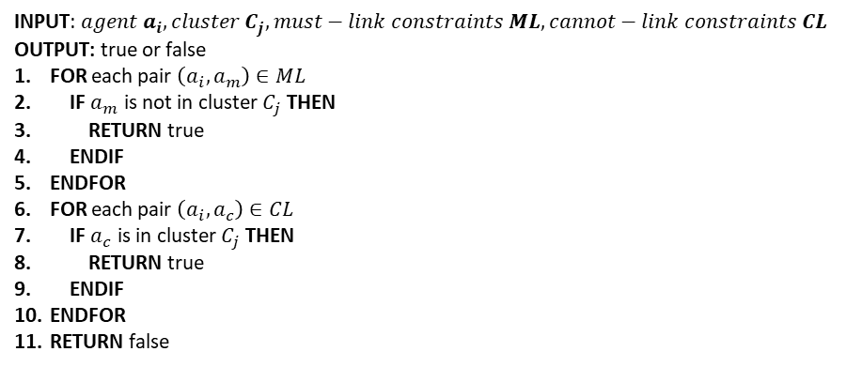
Functions
LCC_CKMeans algorithm – Violate-Constraints function
INPUT: ${agent a}_{i}, cluster C_{j}, must−link constraints ML, cannot−link constraints CL$
OUTPUT: true or false
FOR each pair $\left(a_{i}, a_{m}\right)∈ML$
IF $a_{m}$ is not in cluster $C_{j}$ THEN
RETURN true
ENDIF
ENDFOR
FOR each pair $\left(a_{i}, a_{c}\right)∈CL$
IF $a_{c}$ is in cluster $C_{j}$ THEN
RETURN true
ENDIF
ENDFOR
RETURN false

